Slide 1
Twitter sentiment and Stock price
Xinpeng Shen, Xiaochen Jin

Slide 2
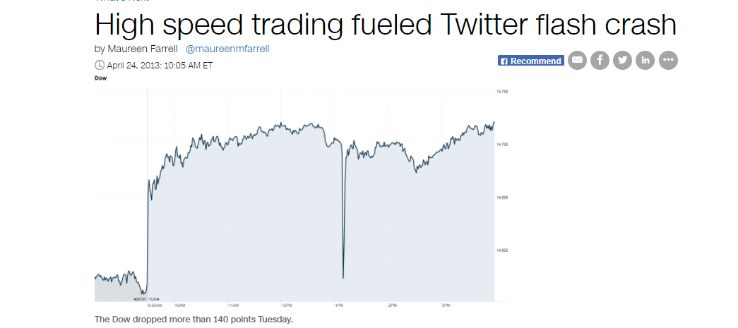
“One scary -- and false -- tweet, and the Dow quickly plunged 140 points, or roughly 1%. Many are pointing fingers at high speed trading by computers for the swift decline.”
-- http://money.cnn.com/2013/04/24/investing/twitter-flash-crash/

Slide 3
Background
It’s known that news have significant impact on High-Speed computer trading -- what can we extract from historical streaming tweets
Text mining and NLP(natural language processing) have been a hot topic in data science world
Tweets are “open data”

Slide 4

Workflow
Tweets Extracting
Text Cleaning
Text Tokenized
Positive
Negative
Sentiment Analysis

Slide 5
Set up connection to Twitter Application Management Portal
Extracting tweets by searching keywords.
“$AAPL”, “$SPY”, “$FB”
Limitations:
Historical tweets as far as 10 days
First 140 words of each tweets
Tweets Extracting
Text Cleaning
Text Tokenized
Pos
Neg
Sentiment Analysis

Slide 6
Tweets Extracting
Remove Punctuation and Special symbols. (#, !, @, http://) using Regular Expression
Text Cleaning
Text Tokenized
Pos
Neg
Sentiment Analysis

Slide 7
Splitting sentence into words
E.g.
I love iphone! I will buy $AAPL
Tweets Extracting
Text Cleaning
Text Tokenized
Pos
Neg
I | Love | iphone | will | buy
Sentiment Analysis

Slide 8
Existing Positive and Negative word dictionary. Developed by other researchers
Tweets Extracting
good
nice
amaze
...
trash
weak
bad
...
Text Cleaning
Text Tokenized
Pos
Neg
Sentiment Analysis

Slide 9
Tweets Extracting
Comparing our tokens with positive and negative word dictionary
Generating summary statistics and analysis results( will show later)
Revise the word dictionary by adding positive or negative word
E.g. “The stock is really cheap”
Text Cleaning
Text Tokenized
Pos
Neg
Sentiment Analysis

Slide 10
Results I
Visualize the frequency of positive and negative words for each stock
Frequency plot
Word cloud

Slide 11
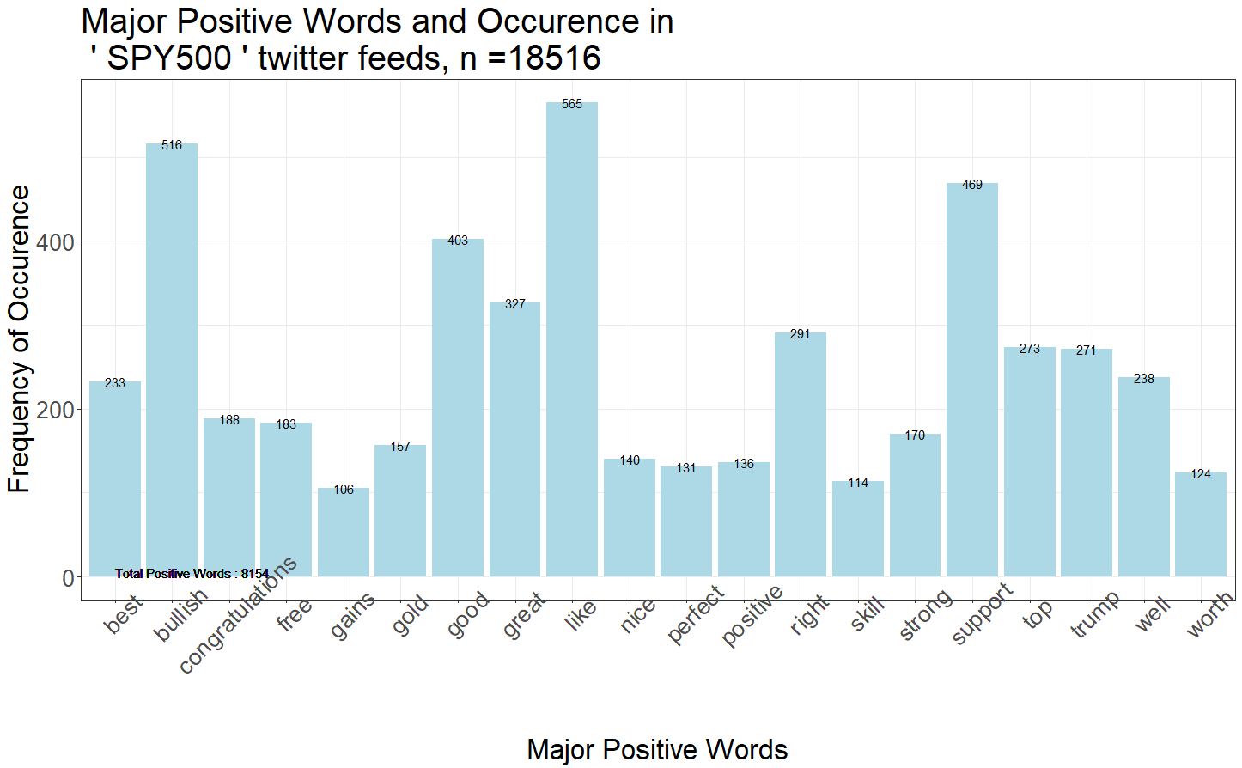
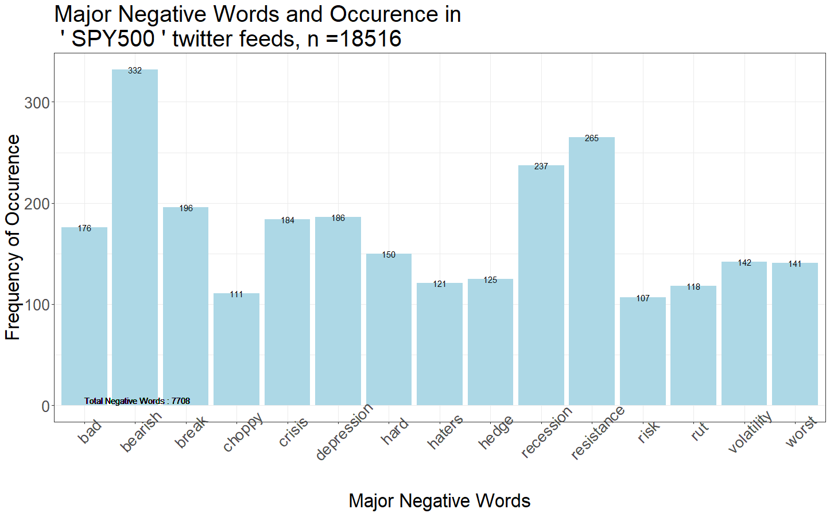
Positive and Negative occurrence in Tweets about SPY500

Slide 12
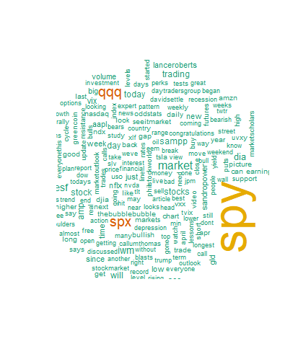
Word cloud of SPY

Slide 13
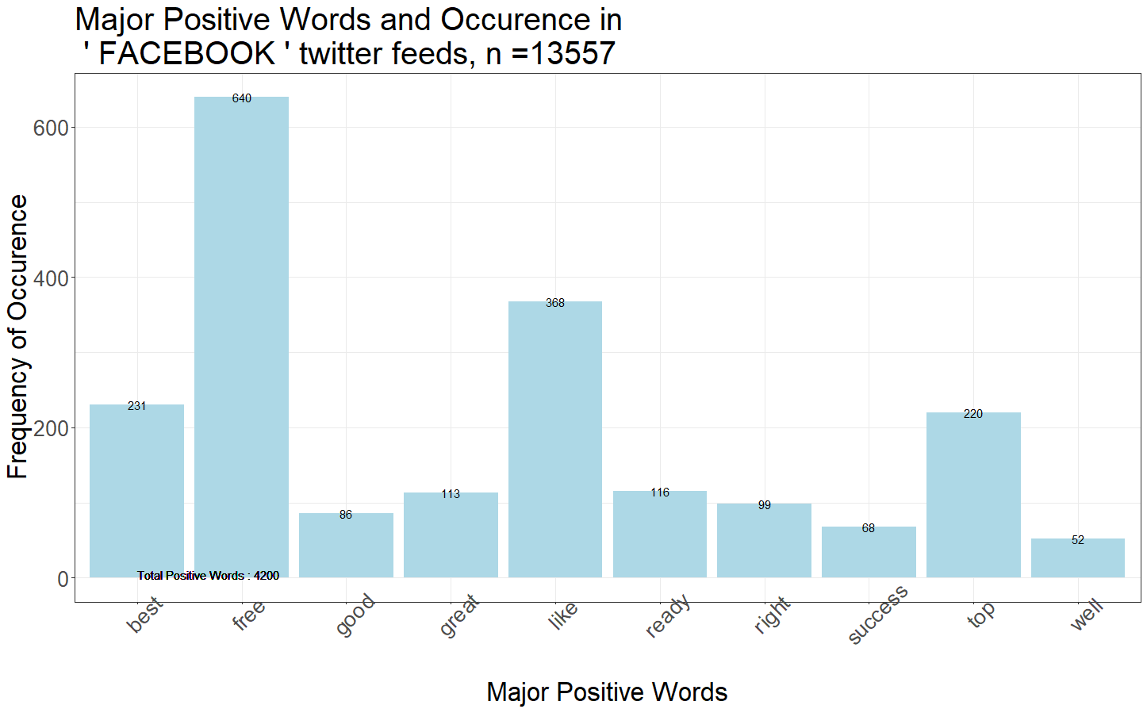
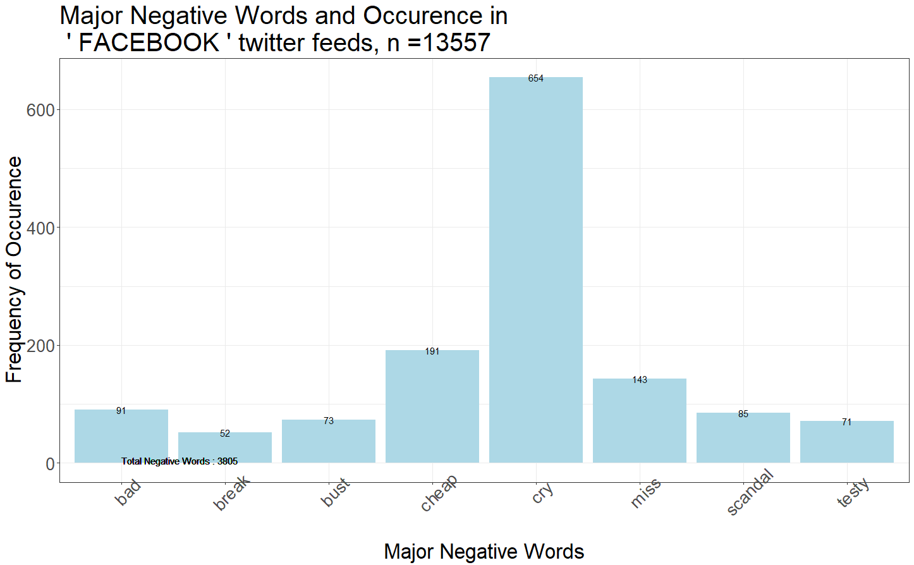
Positive and Negative Occurrence in FB tweets

Slide 14
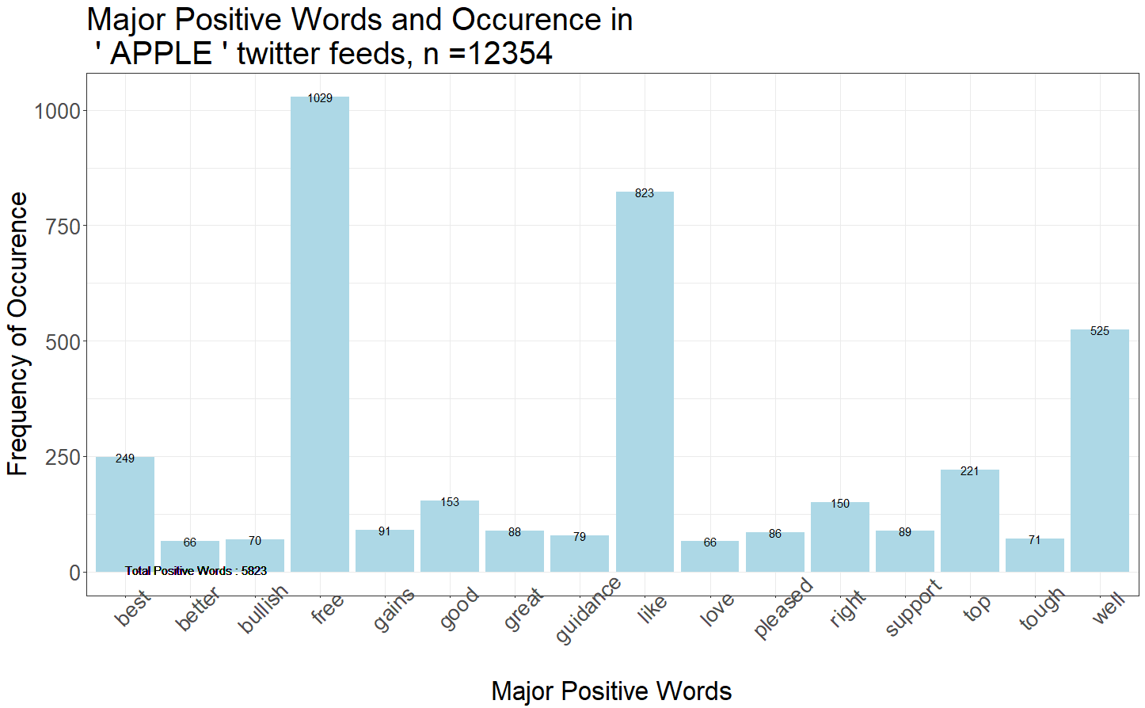
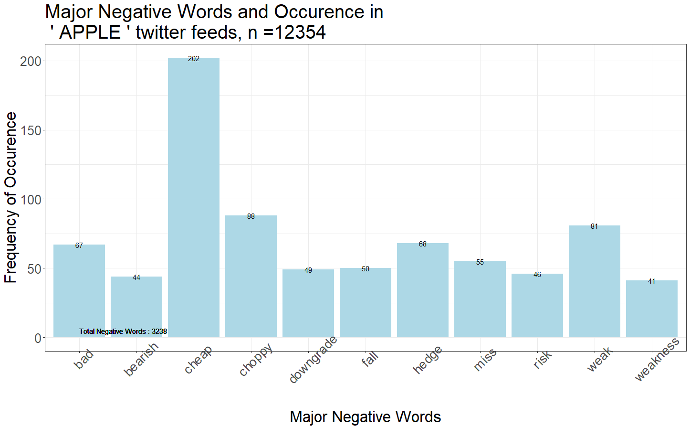
Positive and Negative Occurrence in Apple tweets

Slide 15
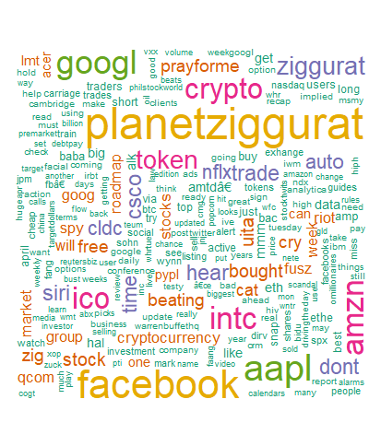
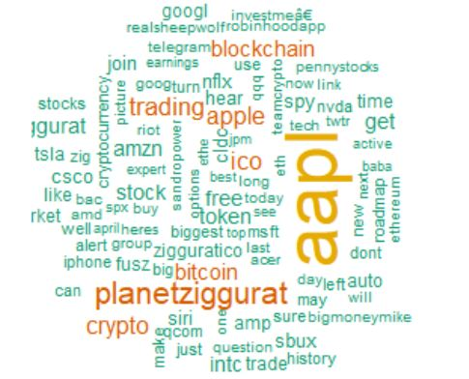
Word Clouds of Apple vs Facebook

Slide 16
Results II
Time series
Time series of Twitter Sentiment
Time series of Stock price

Slide 17
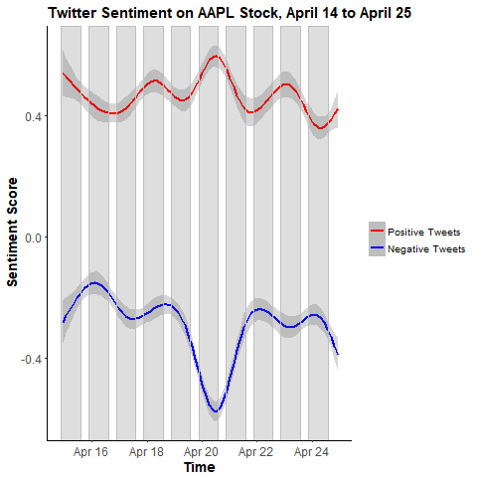
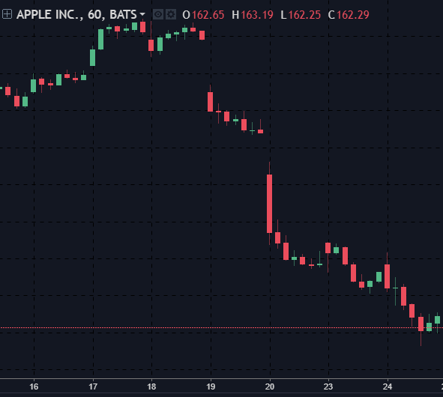
12354 Tweets

Slide 18
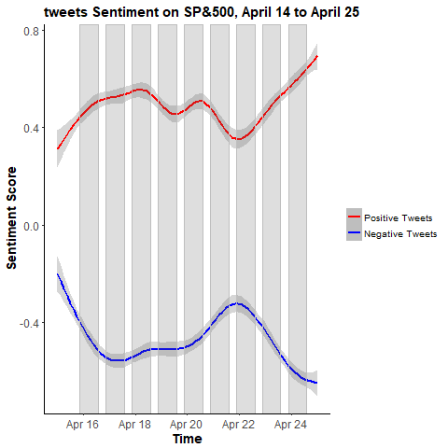
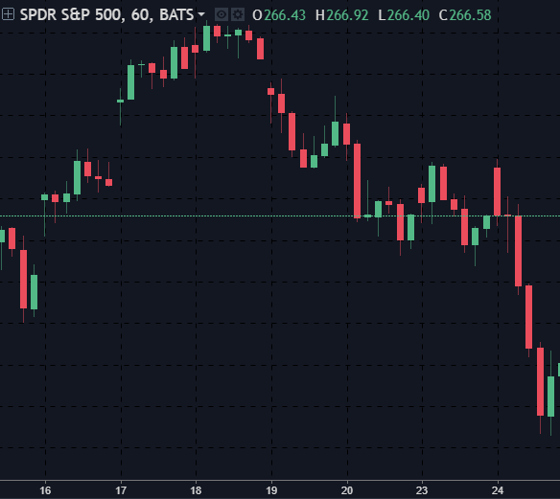
18516 Tweets

Slide 19
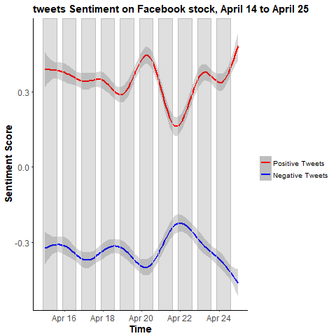
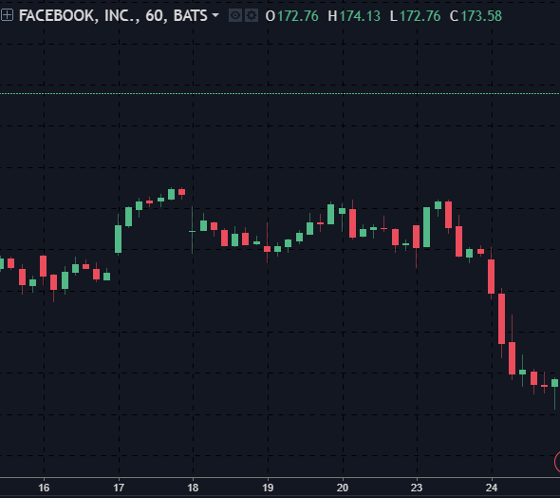
13557 Tweets

Slide 20
Discussion of Results
Strong visual correlation between sentiment score and stock market price
Due to limitation of data point, we can’t fit time series model, but the sentiment might be a good variable
Causal relation is not very clear, need intraday stock price movement

Slide 21
Further Direction
As we learning and exploring the Text mining filed, we realized there are a lot to do.
Keep updating our Positive and Negative word dictionary
Labeling the tweets by hand, make the sentiment analysis into a supervised learning problem. → Creating our text mining model, special word dictionary
Using new technique Word2vec, topic modeling(Latent Dirichlet allocation)
Adding new text source, like news

Slide 22
Reference
1.Twitter Sentiment Analysis Tutorial, https://rpubs.com/abNY2015/90345
2. News Sentiment Analysis Using R to Predict Stock Market Trends. Anurag Nagar and Michael Hahsler, Southern Methodist University, http://past.rinfinance.com/agenda/2012/talk/Nagar+Hahsler.pdf
3. Short Introduction to tm.plugin.webminin, Mario Annau https://cran.r-project.org/web/packages/tm.plugin.webmining/vignettes/ShortIntro.pdf
4. Ingo Feinerer. Introduction to the tm Package Text Mining in R. https://cran.r-project.org/web/packages/tm/vignettes/tm.pdf

Slide 23
Thank you & any questions?

